Slide 1

BikeStores SQL Analysis
A comprehensive data analysis project examining retail performance, customer behavior, and operational efficiency through advanced SQL techniques.

Slide 2





Project Overview
Dataset Analyzed
BikeStores retail database covering sales transactions, customer profiles, inventory, and staff performance metrics
SQL Techniques
Window Functions, Common Table Expressions (CTEs), Ranking Functions, EXISTS clauses, and Complex Aggregations
Key Focus Areas
Sales patterns, customer segmentation, staff productivity, and product performance across categories and stores
Business Value
Actionable insights for inventory optimization, sales strategy, and operational decision-making

Slide 3
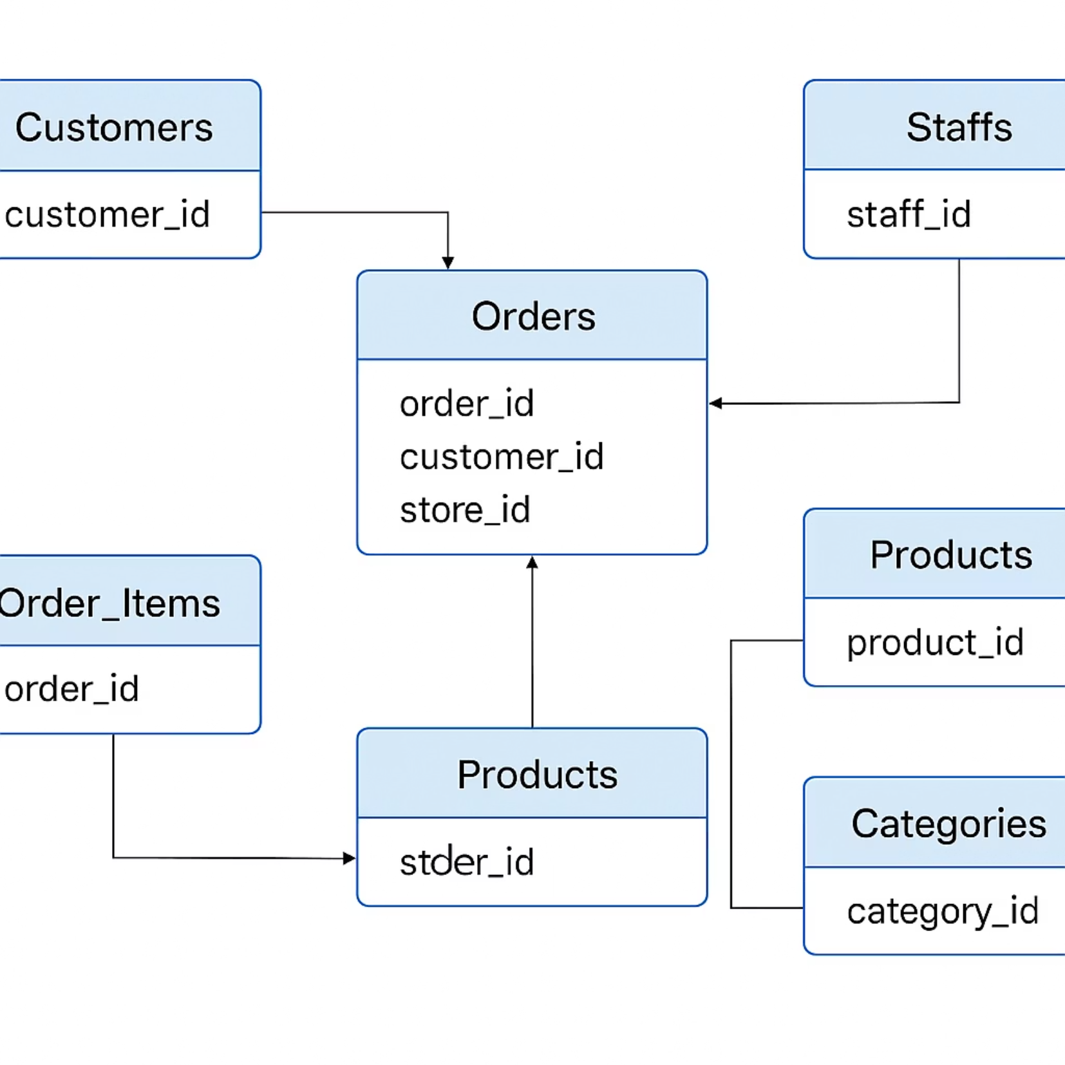
Dataset Schema
The BikeStores database consists of interconnected tables tracking sales transactions, product catalog, customer information, and store operations. This relational structure enables comprehensive analysis across multiple business dimensions.
Key relationships include orders linked to customers and staff, order items connecting to products and inventory managed across multiple store locations.

Slide 4

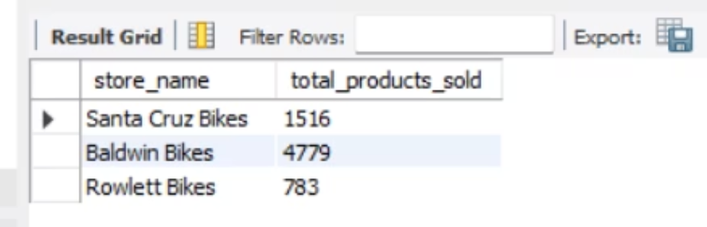
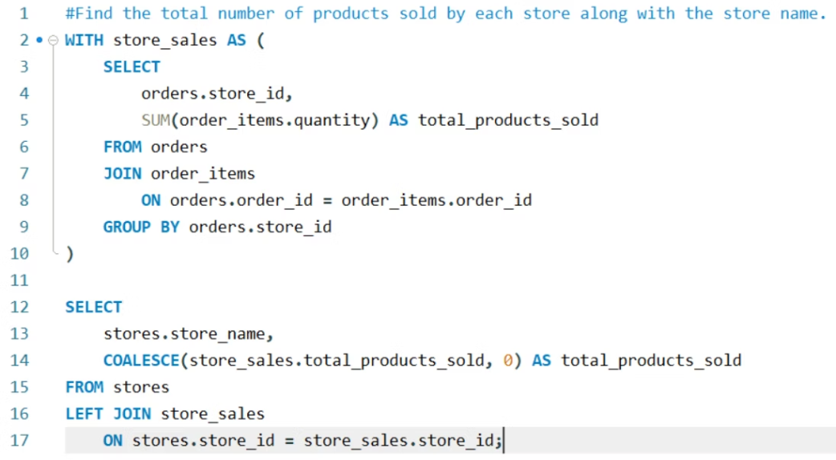
Total Products Sold by each Store
SQL Query Approach
Store Performance
This analysis aggregates order item quantities across stores by joining order and store tables, revealing which locations drive the highest product volume.
Baldwin Bikes leads with 4779 units sold, while Santa Cruz Bikes follows with 1516 units and Rowlett Bikes trails at 783 units.

Slide 5
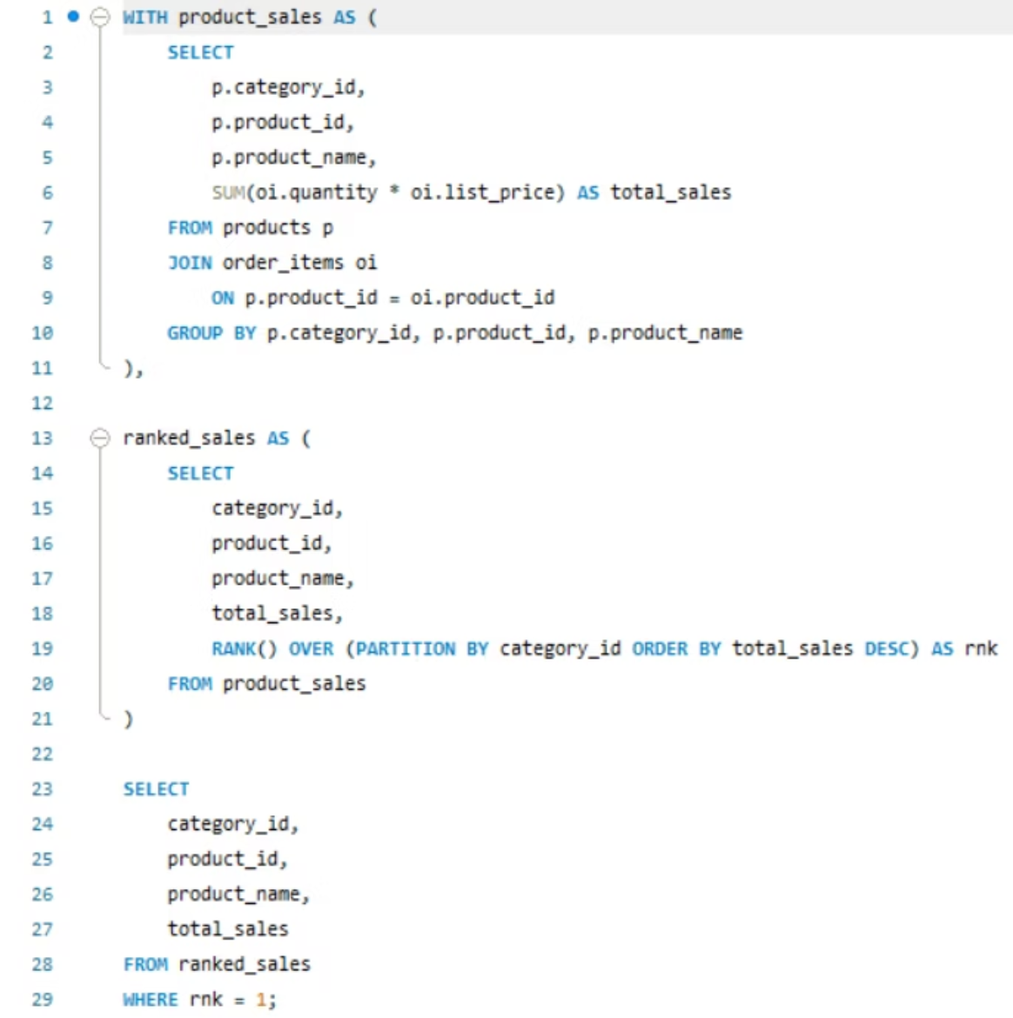
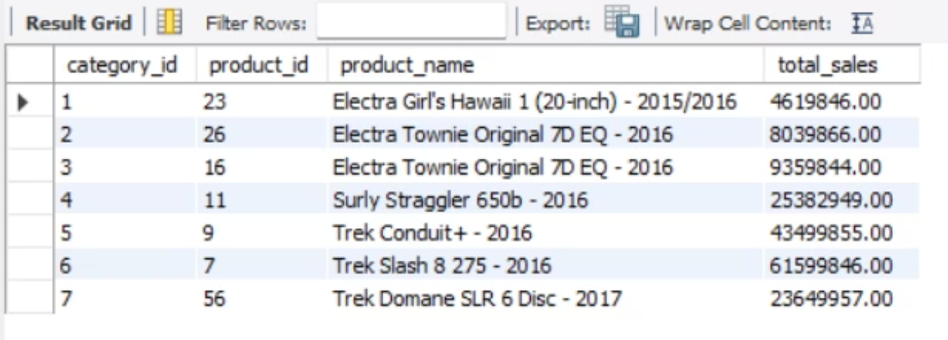
Top Revenue Products by Category
Identifying the highest-grossing product in each category reveals which models drive the most revenue and should be prioritized in inventory and marketing strategies.
Trek Slash 8 275 - 2016 dominates Road Bikes with $61,599,846.00 in sales, while Electra Girl 's Hawaii 1 (20-inch) - 2015/2016 with $4,619,846.
The query uses window functions to rank products within categories based on total sales value (quantity × price), filtering for top performers.

Slide 6



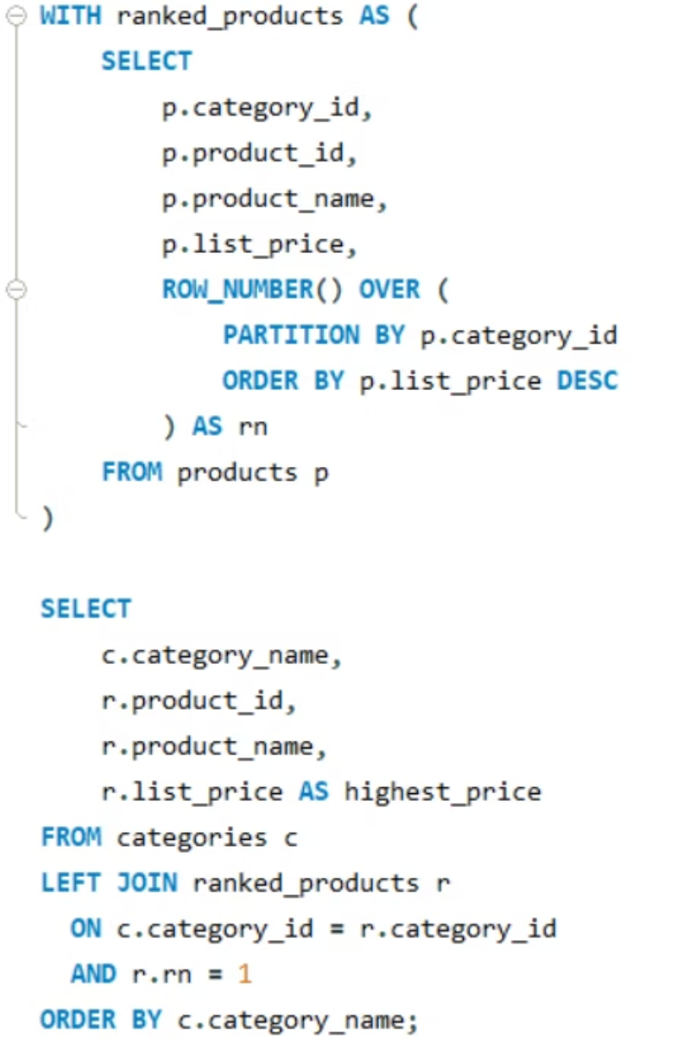
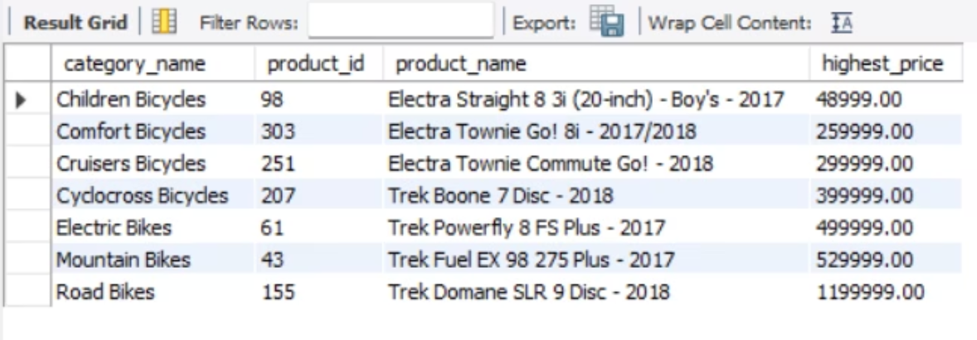
Premium Products: Highest Price by Category
Query Logic
Price Analysis
Market Insight
Ranking function identifies the most expensive product per category
Reveals premium positioning and pricing strategy across product lines
Helps identify luxury segments and high-margin opportunities
Premium pricing ranges from $1,199,999.00 for the Trek Domane SLR 9 Disc in Road Bikes down to $259.99 for children's models, showing significant category differentiation.

Slide 7

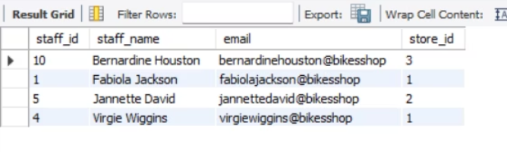
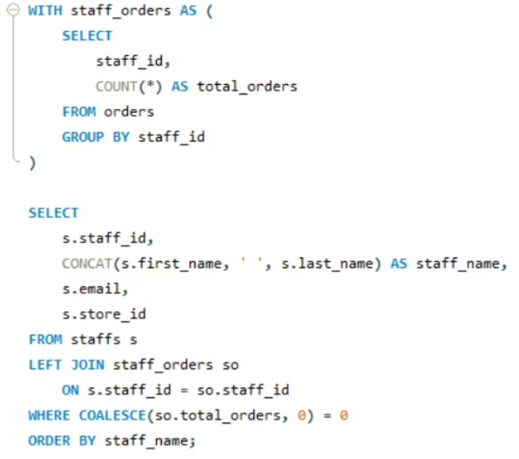
Staff Members with No Sales
This analysis identifies staff members who have not made any sales transactions over a specified period. It is critical for pinpointing potential training needs, addressing performance issues, or optimizing staffing allocations to ensure all team members contribute effectively and to identify opportunities for improvement.
SQL Query Approach
Key Findings
To identify staff members without sales, we employ a database query using either a NOT EXISTS clause or a LEFT JOIN clause. This approach links the 'Staff' table with the 'Orders' table, effectively filtering for staff IDs that do not have corresponding entries in the sales records over the specified period.
Our analysis revealed that four staff members have no recorded sales transactions: Virgie Wiggins (Store 1), Fabiola Jackson (Store 1), Jannette David (Store 2), Bernardine Houston (Store 3). This highlights an immediate need for further investigation, potentially leading to targeted sales training, comprehensive performance reviews, or strategic reassignment to roles better suited to their skills, ultimately optimizing team performance.

Slide 8
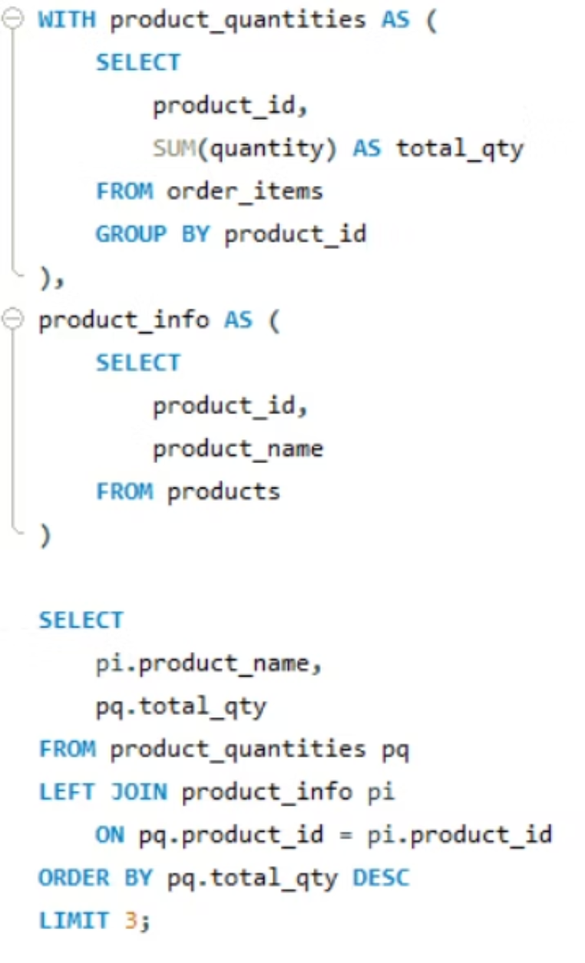
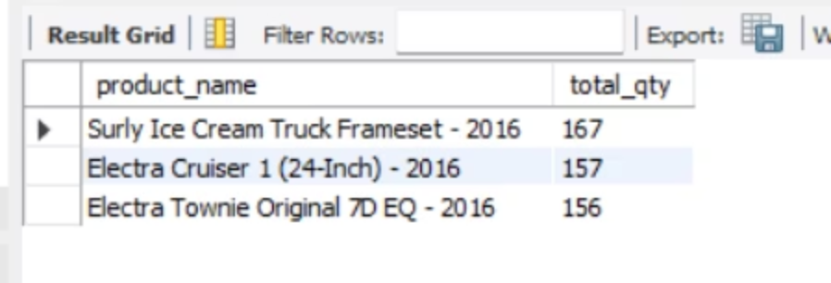
Top 3 Best-Selling Products
Volume leaders reveal customer preferences and fast-moving inventory that requires consistent stock management and promotional support.
🥇 Surly Ice Cream Truck Frameset
🥈 Electra Cruiser 1 (24inch)
🥉 Electra Townie Original
167 units sold
157 units sold
156 units sold
Key Insights & Recommendations
The top-selling products indicate a strong demand across diverse segments: high-end enthusiasts (fat bikes) and everyday commuters (townie bikes), alongside premium mountain bikes.
Diverse Market Appeal: Cater to both niche high-performance segments and broader casual riding markets.
Targeted Inventory: Ensure consistent stock for these proven sellers to avoid lost sales.
Promotional Focus: Highlight features that appeal to each product's core demographic in marketing efforts.
Growth Opportunities: Explore expanding offerings in comfortable, commuter-friendly bicycles and specialized adventure bikes.

Slide 9

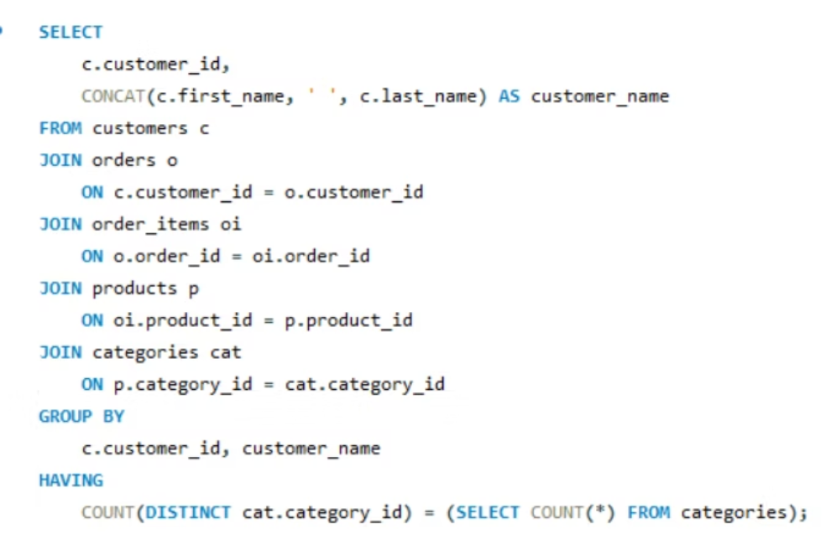
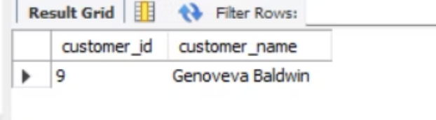
Cross-Category Customer Champions
Customers who purchase across all product categories represent the most valuable, engaged segment—demonstrating brand loyalty and diverse cycling interests that warrant VIP treatment and targeted retention strategies.
Only 1 customers have ordered from all categories, representing an extremely rare and valuable customer profile worth studying and nurturing.
The query uses EXISTS clauses to identify customers with purchases spanning every product category, filtering for true multi-category buyers.

Slide 10
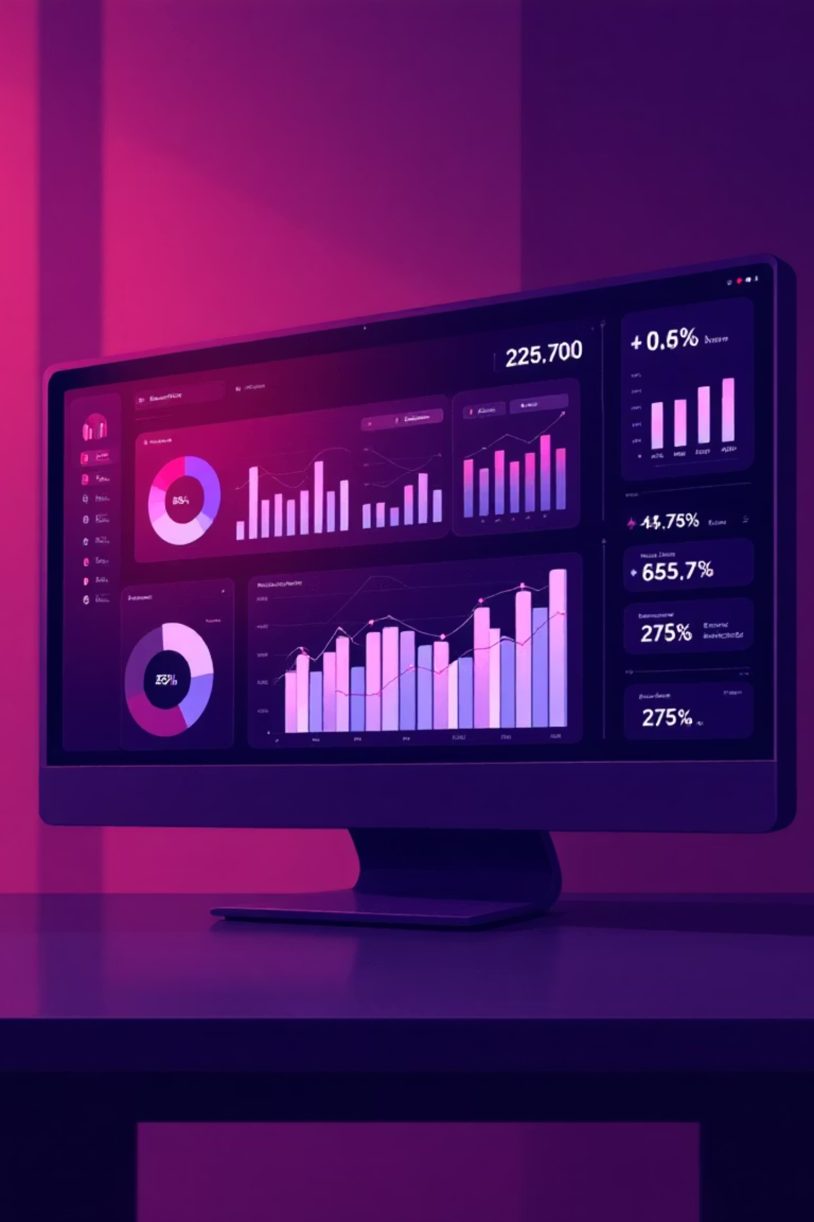
Key Insights Summary
Product Performance
Customer Behavior
Trek dominates premium segments with models like Domane SLR 9 Disc generating $172K+ in sales
Revenue concentration: Small customer subset drives disproportionate sales value
Electra Townie leads in volume with 305 units sold, indicating strong casual market demand
Only 2 customers purchase across all categories—untapped cross-selling opportunity
Certain categories show minimal activity, suggesting potential discontinuation or promotional needs
Customer segmentation reveals need for targeted retention and upselling strategies
Operational Findings
Baldwin Bikes leads with 5,613 units sold across locations
Staff performance varies significantly—some personnel show zero recorded orders
Top performers exceed store averages, suggesting best practices worth replicating

Slide 11

Key Takeaways
SQL Mastery
Real-World Application
Business Dataset Fluency
This project significantly enhanced analytical SQL capabilities, demonstrating proficiency with advanced query techniques that go beyond basic SELECT statements to deliver sophisticated business intelligence.
Successfully applied SQL skills to solve authentic business challenges, translating complex data structures into clear insights that drive strategic decisions and operational improvements.
Developed a deeper understanding of wholesale database architecture, learning how transactional systems capture and organize information to support both operational needs and analytical reporting.

Slide 12

Thank You

